Slide 1

DETECTION OF PIPE CORROSION
BANGALORE INSTITUTE OF TECHNOLOGY K. R. Road, V. V. Pura, Bengaluru – 560004 Department of Computer Science and Engineering
Presented By
16P44
NIKHIL 1BI16CS083
NIKHIL KULKARNI 1BI16CS084
PAVAN KUMAR S 1BI16CS093
PAVAN S 1BI16CS094
Under the Guidance of:
Dr. Gunavathi H S
Assistant professor
Dept. of CSE
BIT BANGALORE

Slide 2
Agenda
Introduction
Motivation and Objectives
Literature Survey
Analysis Modelling
Sequence Diagram
Data Flow Diagram
SRS Formulation
Architecture
Algorithm Design/Implementation
Result
Application
Conclusion and Future Work
References

Slide 3
INTRODUCTION
The oil, gas, chemical and petro-chemical industries operate on hundreds of kilometres of pipelines, often transporting hydrocarbons and non-hydrocarbons fluids.
Each year , there are hundreds of pipeline failures, resulting into pollution, loss of transportation capacity, loss of oil and gas availability, and repair expenses.
Therefore, inspection of pipelines at regular intervals and maintaining the integrity of pipeline system is a task of the highest priority

Slide 4
MOTIVATION:
Recognition of corroded pipelines in unhabituated area is quiet an arduous process .
Using the knowledge of modern emerging machine learning techniques for identification purpose.
OBJECTIVES:
Design and implement method for detection of corrosion.
To minimize manual labour and capital spent on Repair Expenses.
Provide a system application to identify whether the pipe is corroded.

Slide 5
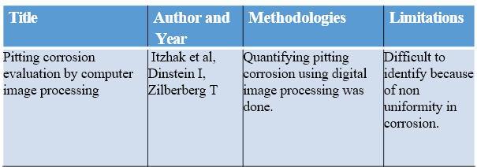
Literature Survey

Slide 6
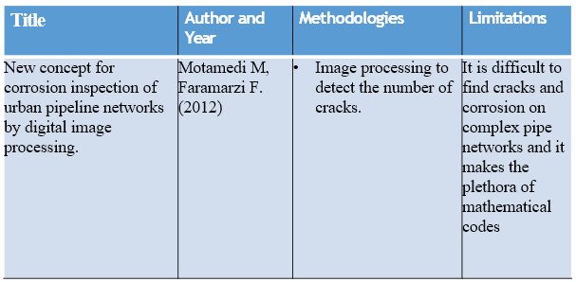

Slide 7
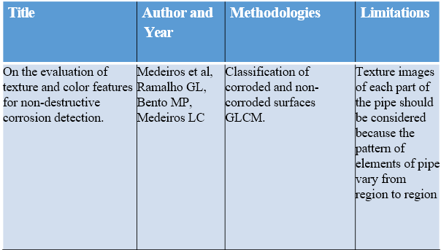

Slide 8
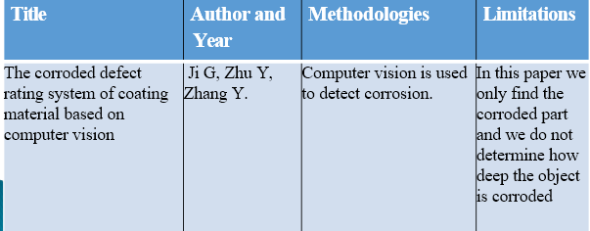

Slide 9
System Requirement Specification
FUNCTIONAL REQUIREMENTS
Recognition and Classification: The system should be able to identify the pattern and classify the image.
Training the datasets: The datasets required to train the system should be large in number and the images acquired during registration should be in different angles.
Feature Extraction: All the important features should be extracted from the image.

Slide 10
NON FUNCTIONAL REQUIREMENTS.
Usability: The interface in the application should be user-friendly and smooth.
Maintainability: The Model can be trained with more new images.
Compatibility : The system can co-exist with another system in the same environment.

Slide 11
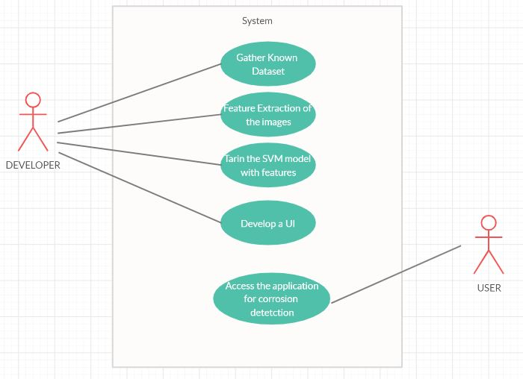
Analysis Modelling
Figure 1: Use case diagram

Slide 12
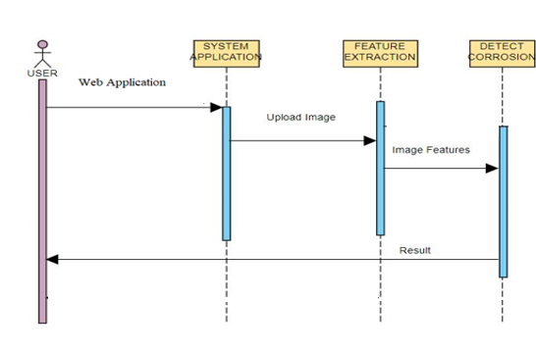
Sequence Diagram
Figure 2: Sequence diagram

Slide 13
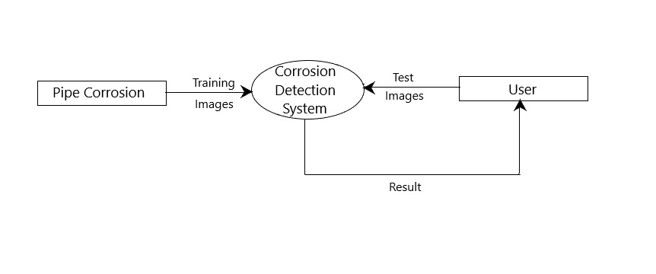
DFD level 0
Figure 3: Data flow diagram level 0 for pipe corrosion detection.

Slide 14
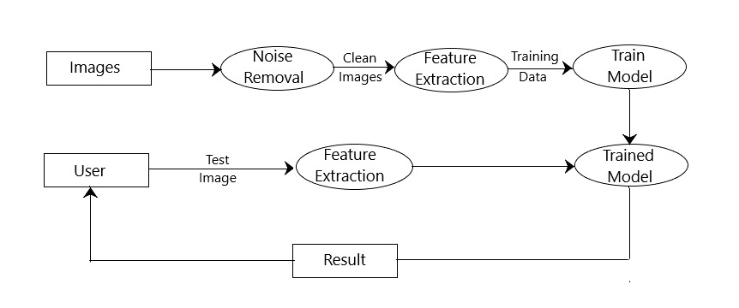
DFD level 1
Figure 4: Data flow diagram level 1 for pipe corrosion detection.

Slide 15
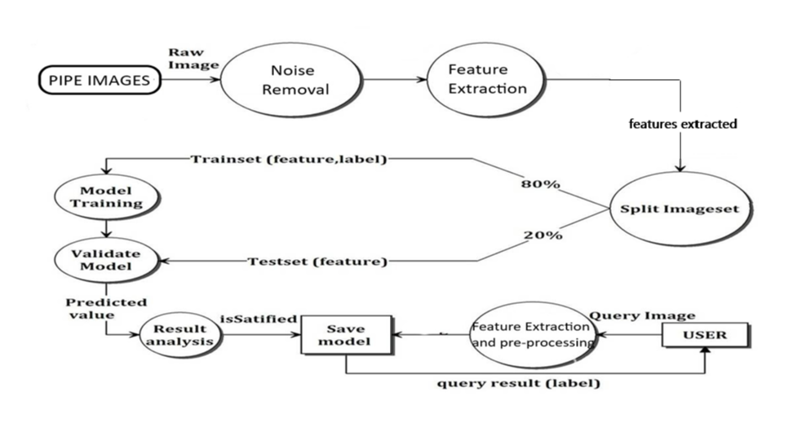
DFD level 2
Figure 5: Data flow diagram level 2 for pipe corrosion detection.

Slide 16
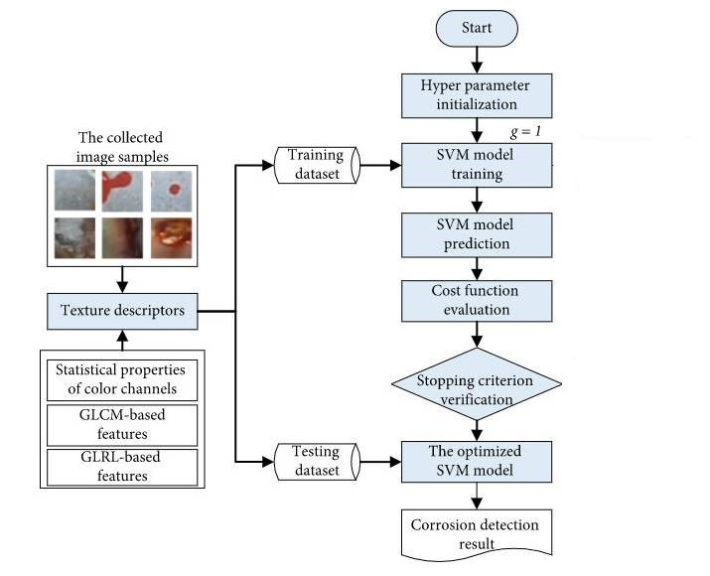
System Architecture
Figure 6: System architecture for detection of pipe corrosion.

Slide 17
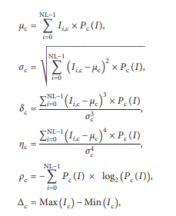
Algorithm Design/Implementation
Statistical Properties of Color Channels
Color moments represent the distribution of each color channel in an image.
The mean (μc), standard deviation (σc), skewness (δc), kurtosis (ηc), entropy (ρc), and range (Δc) of color value are calculated:

Slide 18
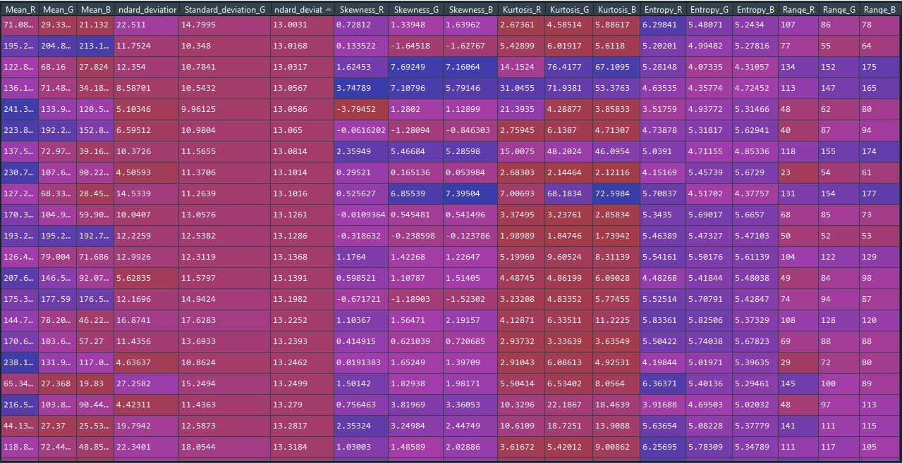

Slide 19
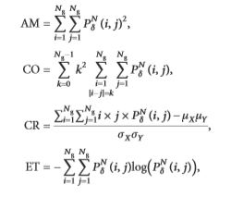
Gray-Level Co-occurrence Matrix(GLCM)
Considers the spatial relationship of pixels .
The GLCM functions characterize the texture of an image by calculating how often pairs of pixel with specific values and in a specified spatial relationship occur in an image, creating a GLCM, and then extracting statistical measures from this matrix.
Four GLCMs with r=1 and θ=0°, 45°, 90°, and 135° can be established. Accordingly, angular second moment (AM), contrast (CO), correlation (CR), and entropy (ET) can be computed to serve as texture descriptors

Slide 20
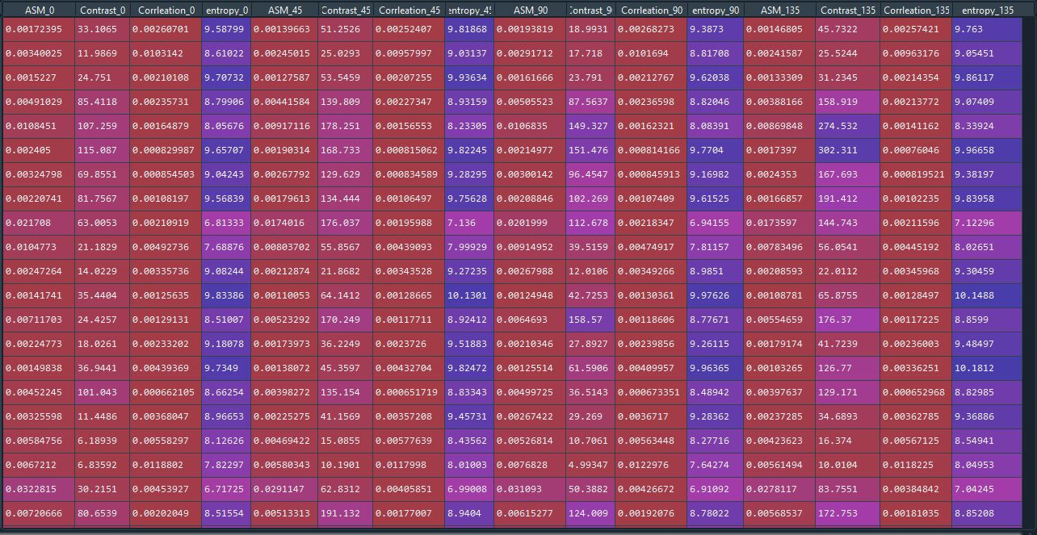

Slide 21
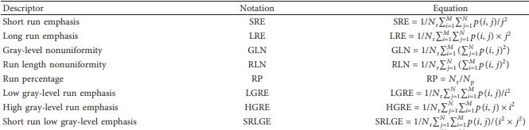
Gray-Level Run Lengths (GLRL)
This method is highly effective in discriminating textures featuring different fineness.
Long gray-level runs are observed more frequently in a coarse texture and a fine texture typically has more short runs.
Quantize the image data into a specified number of discrete gray levels.

Slide 22
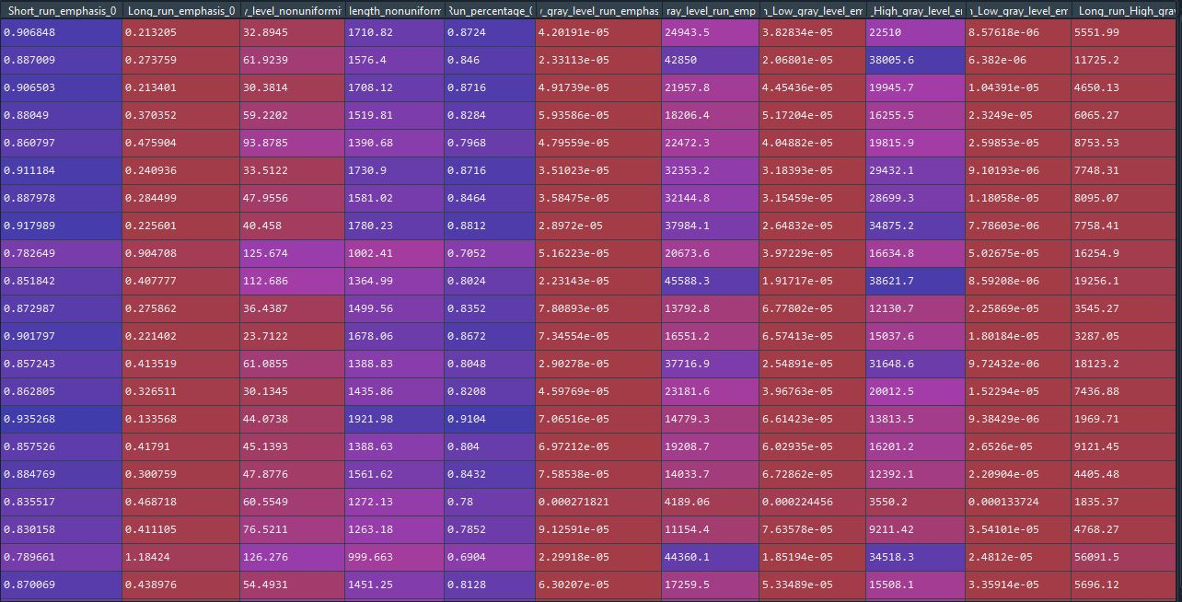

Slide 23
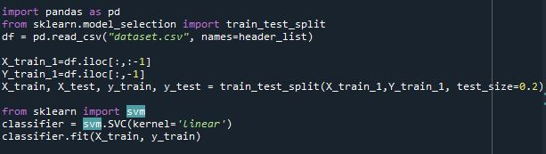
Training SVM Model
The pre-processed data is split into training and test data
The SVM model is trained with data provided and tries to identify the pattern for corroded and non corroded image

Slide 24
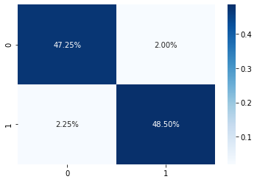
RESULTS
TRUE POSITIVE= 47.25
TRUE NEGATIVE= 48.50
FALSE POSITIVE= 2.00 FALSE NEGATIVE= 2.25
Classification Accuracy Rate(CAR)
CAR=(TP+TN)/(TP+TN+FP+FN)*100
CAR=95.75%
Figure 8: CONFUSION MATRIX FOR THE CLASSIFICATION MODEL

Slide 25
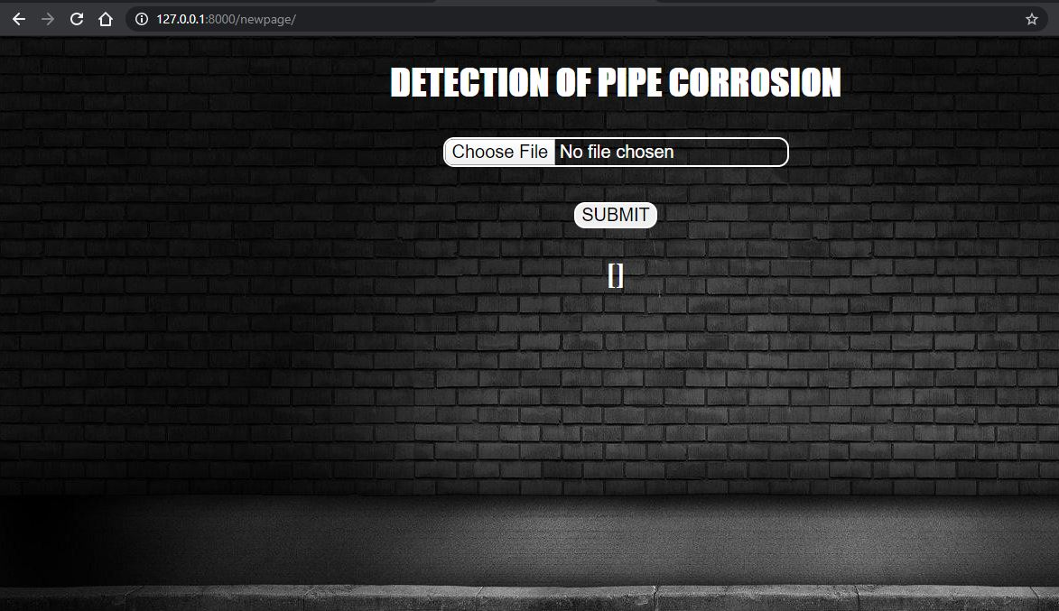
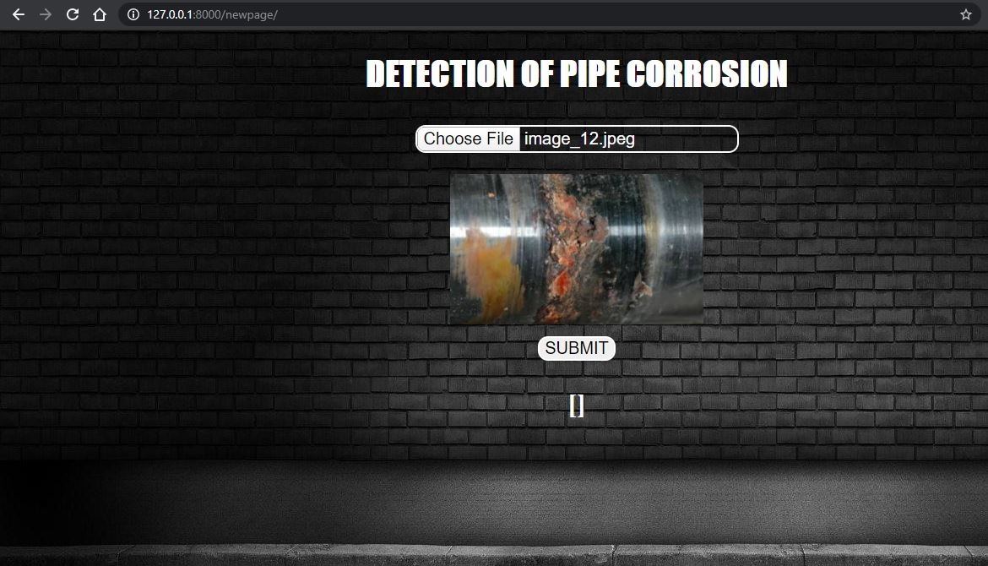
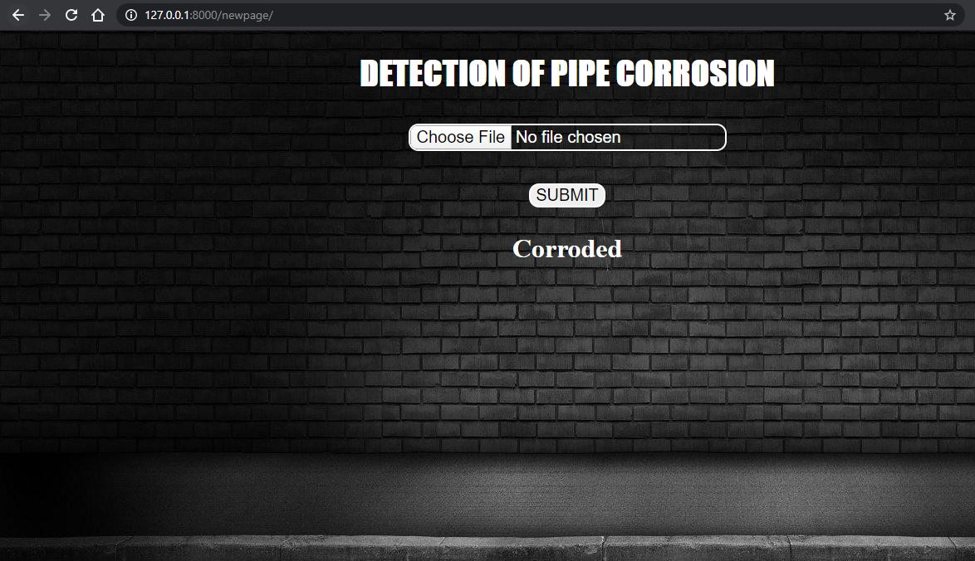
Figure 9: The Web application developed for the developed model

Slide 26
APPLICATIONS:
Cost-effective maintenance strategies.
Maintaining Integrity of Pipeline System.
Useful Tool to evaluate the status of pipe systems

Slide 27
CONCLUSION AND FUTURE WORK
This model uses an automatic method based on image processing and machine learning for pipe corrosion recognition.
Reliable method for detection of Corrosion
Further extensions of the model may include the utilization of other advanced machine learning for data classification, employment of other metaheuristic for model optimization, employment of higher-order statistical features as input to machine learning based classifiers.

Slide 28
REFERENCES
[1] Itzhak D, Dinstein I, Zilberberg T. Pitting corrosion evaluation by computer image processing. Corrosion Science. 2014 Jan 1; 21(1):17-22.
[2]Motamedi M, Faramarzi F, Duran O. New concept for corrosion inspection of urban pipeline networks by digital image processing. Paper presented at: IECON 2015-38th Annual Conference on IEEE Industrial Electronics Society; 2015 Oct 25; Montreal, QC: IEEE; 2015. p. 1551-1556.
[3]Medeiros FN, Ramalho GL, Bento MP, Medeiros LC. On the evaluation of texture and color features for nondestructive corrosion detection. EURASIP Journal on Advances in Signal Processing. 2015 Dec 1; 2015(1):817473.
[4] Ji G, Zhu Y, Zhang Y. The corroded defect rating system of coating material based on computer vision. In Transactions on Edutainment VIII 2016 (pp. 210-220). Springer, Berlin, Heidelberg.

Slide 29
THANK YOU

